Slide 1
Computational Intelligence in Wireless Sensor Networks: A Survey
Author’s name:
Raghavendra V. Kulkarni, Senior Member, IEEE, Ann Förster,Member, IEEE and
Ganesh Kumar Venayagamoorthy, Senior Member, IEEE
Submitted by:
Partha Pritam Paul(14-15-059)
Bishal Paul(14-15-066)

Slide 2
ABSTRACT
Wireless Sensor Networks(WSNs) are networks of distributed autonomous devices that can sense or monitor physical or environmental conditions cooperatively. WSNs face many challenges, mainly caused by communication failures, storage and computational constraints and limited power supply. Paradigms of computational intelligence (CI) have been successfully used in recent years to address various challenges such as data aggregation and fusion, energy are routing, task scheduling, security, optimal deployment and localization.
CI provides adaptive mechanisms that exhibit intelligent behavior in complex and dynamic environments like WSNs . CI brings about flexibility, autonomous behavior, and robustness against topology changes, communication failures and scenario changes An extensive survey of CI applications to various problems in WSNs from various research areas and publication venues is presented in the paper.

Slide 3
INTRODUCTION
A wireless sensor network is a network of distributed autonomous devices that can sense or monitor physical or environmental conditions cooperatively .
WSNs are used in numerous applications such as:
Environmental monitoring
Habitat monitoring
Prediction and detection of natural calamities
Medical monitoring
Structural health monitoring
WSNs consist of a large number of small, inexpensive, disposable and autonomous sensor nodes that are generally deployed in an ad hoc manner in vast geographical areas for remote operations.

Slide 4
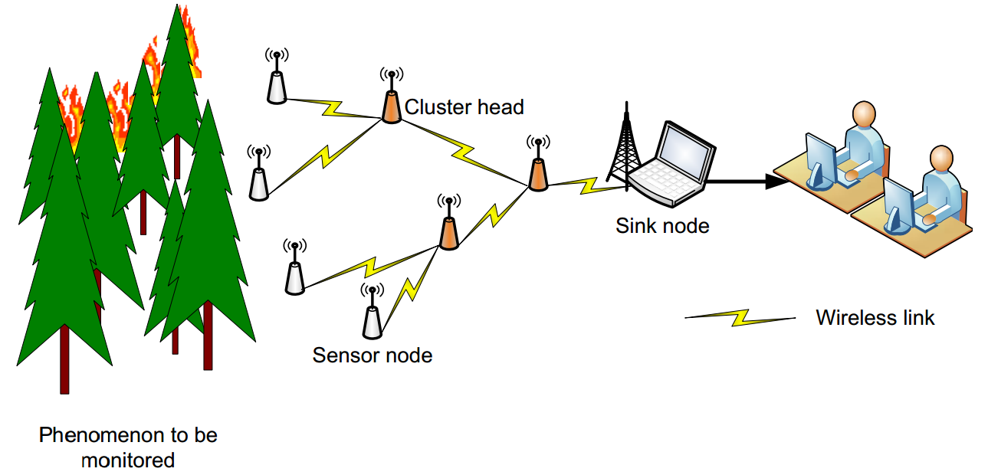
Fig 1: Architecture of a typical wireless sensor network
Sensor nodes are severely constrained in terms of storage resources, computational capabilities, communication bandwidth and power supply.
Typically, sensor nodes are grouped in clusters, and each cluster has a node that acts as the cluster head. All nodes forward their sensor data to the cluster head, which in turn routes it to a specialized node called sink node (or
base station) through a multi-hop wireless communication as shown in Figure 1.

Slide 5
CHALLENGES IN WIRELESS SENSOR NETWORKS
Real deployments of Wireless Sensor Networks (WSN) usually implement one of the three general applications:
Periodic reporting: Periodic reporting is by far the most used and the simplest application scenario, in which at regular intervals the sensors sample their environment, store the sensory data, and send it to the base station .
Event detection : In event detection applications , nodes sense the environment and evaluate the data immediately for its usefulness. If useful data (an event) is detected, the data is transmitted to the base station(s). The data traffic can hardly be predicted: events usually occur randomly and the resulting data traffic is sporadic .
Database-like storage : database-like storage systems , are similar to event- based systems. All sensory data (regular sampling or events) is stored locally on the nodes. Base stations search for interesting data and retrieve it from the nodes directly. The main challenge in these applications is to store the data in a smart way for fast search and retrieval .

Slide 6
PROPERTIES OF WSN DEPLOYMENTS
Wireless ad hoc nature: A fixed communication infrastructure does not exist. The shared wireless medium places additional restrictions on the communication between the nodes and poses new problems like unreliable and asymmetric links. But, it provides the broadcast advantage: A packet transmitted by a node to another is received by all neighbors of the transmitting node.
Mobility and topology changes: WSNs may involve dynamic scenarios. New nodes may join the network, and the existing nodes may either move through the network or out of it. Nodes may cease to function, and surviving nodes may go in or out of transmission radii of other nodes. WSN applications have to be robust against node failure and dynamic topology.

Slide 7
PROPERTIES OF WSN DEPLOYMENTS (Cont.)
Energy limitations:
Nodes in most WSNs have limited energy. The basic scenario includes a topology of sensor nodes, and a limited number of more powerful base stations. Maintenance or recharging of the batteries on sensor nodes is not possible after deployment. Communication tasks consume maximum power available to sensor nodes, and in order to ensure sustained long-term sensing operation, communication tasks need to be exercised frugally.
Physical distribution:
Each node in a WSN is an autonomous computational unit that communicates with its neighbors via messages. Data is distributed throughout the nodes in the network and can be gathered at a central station only with high communication costs. Consequently, algorithms that require global information from the entire network become very expensive. Thus, reticent distributed algorithms are highly desirable.

Slide 8
MAJOR CHALLENGES
A brief description of the major WSN challenges addressed by CI techniques is presented in the following subsections:
Design and Deployment
WSNs are used in vastly diversified applications ranging from monitoring a biological system through tissue implanted sensors to monitoring forest fire through air-dropped sensors. In some applications, the sensor nodes need to be placed accurately at predetermined locations, whereas in others, such positioning is unnecessary or impractical. Sensor network design aims at determining the type, amount and location of sensor nodes to be placed in an environment in order to get a complete knowledge of its functioning conditions
.
Localization Node localization refers to creating location awareness in all deployed sensor nodes. Location information is used to detect and record events, or to route packets using geometric aware routing. Besides, location itself is often the data that needs to be sensed. Localization methods that use time-of-arrival of signals from multiple base stations are commonly used in WSNs.

Slide 9
MAJOR CHALLENGES
C. Energy Aware Routing and Clustering Economic usage of energy is important in WSNs because replacing or recharging the batteries on the nodes may be impractical, expensive or dangerous. In many applications, network life expectancy of a few months or years is desired. Routing refers to determining a path for a message from a source node to a destination node. In densely deployed networks, routing tables take a huge amount of memory, and therefore, hybrids of proactive and reactive methods are suitable for such networks.
D. Scheduling In order to conserve energy, typical sensor nodes remain in sleep mode most of the time, and go into active mode periodically in order to acquire and transmit sensory data. A strict schedule needs to be followed regarding when a node should wake up, sense, transmit (or perform locomotion), ensuring maximum network lifetime. Causing the WSN nodes to take right actions at right time is the major objective of WSN scheduling.

Slide 10
MAJOR CHALLENGES
E. Data Aggregation and Sensor Fusion Sensor fusion is the process of combining of the data derived from multiple sources such that either the resulting information is in some sense better than would be possible with individual sources, or the communication overhead of sending individual sensor readings to the base station is reduced. Due to large-scale deployment of sensors, voluminous data is generated, efficient collection of which is a critical issue. Most widely used non-CI methods for sensor fusion include Kalman filter, Bayesian networks and Dempster-Shafer method.
F. Security Wireless links in WSNs are susceptible to eavesdropping, impersonating, message distorting etc. Poorly protected nodes that move into hostile environments can be easily compromised. Administration becomes more difficult due to dynamic topology.
G. Quality of Service Management QOS is an overused term that has various meanings and perspectives. QOS generally refers to the quality as perceived by the user/application, while in the networking community, QOS is accepted as a measure of the service quality that the network offers to the applications/users. QOS refers to an assurance by the network to provide a set of measurable service attributes to the end-to-end users/applications in terms of fairness, delay, jitter, available bandwidth, and packet loss.

Slide 11
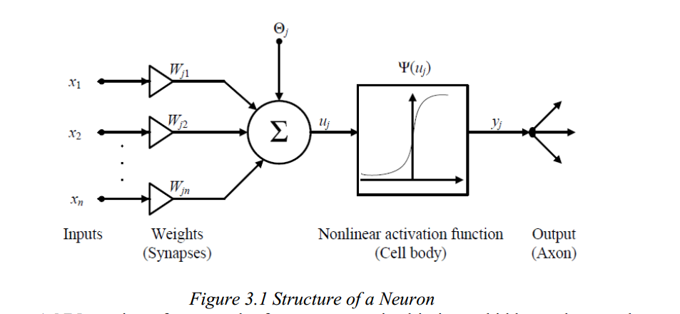
PARADIGMS OF COMPUTATIONAL INTELLIGENCE
CI is the study of adaptive mechanisms that enable or facilitate intelligent behavior in complex and changing environments .CI is defined as the computational models and tools of intelligence capable of inputting raw numerical sensory data directly, processing them by exploiting the representational parallelism and pipelining the problem, generating reliable and timely responses and withstanding high fault tolerance .
NEURAL NETWORKS :

Slide 12
The links that provide weights Wji, to the n inputs of jth neuron xi, i = 1, . . . , n;
An aggregation function that sums the weighted inputs to compute the input to the activation function uj = , where Θj is the bias, which is a numerical value associated with the neuron.
An activation function Ψ that maps uj to vj = Ψ(uj),the output value of the neuron. Some examples of the activation functions are: step, sigmoid, tan hyperbolic and Gaussian function.
FUZZY LOGIC
Fuzzy systems allow the use of fuzzy sets to draw conclusions and to make decisions. Fuzzy sets differ from classical sets in that they allow an object to be a partial member of a set. Fuzzy rules are of the general form: if antecedent(s) then consequent(s), where antecedents and consequents are propositions containing linguistic variables. Antecedents of a fuzzy rule form a combination of fuzzy sets through the use of logic operations. Thus, fuzzy sets and fuzzy rules together form the knowledge base of a rule-based inference system

Slide 13
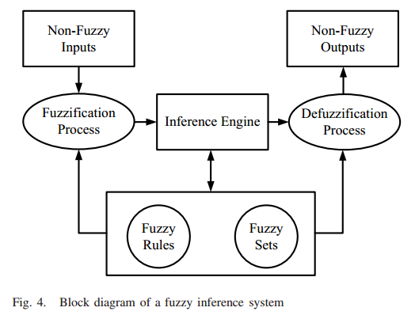

Slide 14
EVOLUTIONARY ALGORITHMS
Evolutionary algorithms model the natural evolution, which is the process of adaptation with the aim of improving survival capabilities through processes such as natural selection, survival-of-the-fittest, reproduction, mutation, competition and symbiosis. EC encompasses a variety of EAs that share a common underlying idea of survival-of-the-fittest.
Following are the major classes of EAs.
• Genetic algorithms (GA), which model genetic evolution • Genetic programming whose individual chromosomes are computer programs • Evolutionary programming which model adaptive behavior in evolution • Evolutionary strategies which model strategy parameters that control variation in evolution • Differential evolution which is identical to GA except for the reproduction mechanism • Cultural evolution which models the evolution of culture of a population and culture’s influence on genetic and adaptive evolution of individuals • Co evolution in which initially “dumb” individuals evolve through cooperation or competition and become fit enough to survive

Slide 15
SWARM INTELLIGENCE
Swarm Intelligence (SI) originated from the study of collective behavior of societies of biological species such as flocks of birds, shoals of fish and colonies of ants. SI is the property of a system whereby collective behaviors of unsophisticated agents interacting locally with their environment cause coherent functional global patterns to emerge.
Particle Swarm Optimization The basic PSO consists of a population (or a swarm) of s particles, each of which represents a candidate solution. The particles explore an n dimensional space in search of the global solution, where n represents the number of parameters to be optimized. Each particle i occupies position xid and moves with a velocity vid, 1 ≤ i ≤ s and 1 ≤ d ≤ n. Particles are initially assigned random positions and velocities within fixed boundaries, i.e.,
xmin ≤ xid ≤ xmax and vmin ≤ vid ≤ vmax (in most cases vmin = -vmax).
Fitness of a particle is determined from its position. The fitness is defined in such a way that a particle closer to the solution has higher fitness value than a particle that is far away. In each iteration, velocities and positions of all particles are updated to persuade them to achieve better fitness.

Slide 16
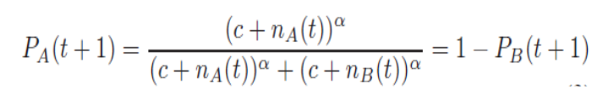
Ant Colony Optimization :
ACO was introduced as a met heuristic for solving combinatorial optimization problems. Foraging ants initially explore surroundings of their nest in a random manner. When an ant finds a source of food, it evaluates quantity and quality of the food and carries some food to the nest. While returning to the nest, the ant deposits a trail of chemical pheromone, which guides other ants to the food source. This characteristic of ant colonies is exploited in artificial ant colonies to solve combinatorial optimization problems. Consider that two paths A and B exist between a nest and a food source, and nA(t) and nB(t) number of ants use them at time step t respectively, then the probability of ant choosing path A at the time step t + 1 is given by

Slide 17
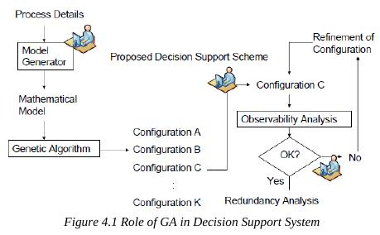
CI BASED SOLUTIONS FOR WSN CHALLENGES
1. EVOLUTIONARY ALGORITHM FOR NETWORK DESIGN
A decision support system based on Genetic Algorithm is proposed. The decision support system is meant for the use of a process engineer who interacts with it to determine. optimal sensor network design as outlined in Figure

Slide 18
CI BASED SOLUTIONS FOR WSN CHALLENGES (cont.)
The process engineer introduces information about the process under stationary operating conditions through a rigorous module called model generator, which involves linear functionalities and non-linear equations.
.
Then the engineer chooses the initial sensor network
from the candidates. The chosen configuration undergoes observability analysis which determines which of the unmeasured variables are observable. Based on the results, the engineer decides whether the information achieved from the configuration is satisfactory or not.

Slide 19

CI BASED SOLUTIONS FOR WSN CHALLENGES (cont.)
where NR(i), Nobs(i) and NC (i) are the normalized values corresponding to the reliability, observability and cost terms, respectively.

Slide 20
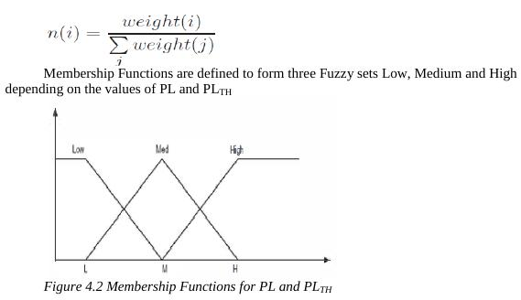
CI BASED SOLUTIONS FOR WSN CHALLENGES (cont.)
2.FUZZY LOGIC FOR DEPLOYMENT:
This technique assumes that the area to be monitored by a sensor network is divided into a square grid of subareas, each having its own terrain profile and a level of required surveillance.

Slide 21
CI BASED SOLUTIONS FOR WSN CHALLENGES (cont.)
3.SWARM INTELLIGENCE FOR LOCALIZATION
Most WSN localization algorithms share a common feature that they estimate the location of nodes using the a priori knowledge of the positions of special nodes called beacon nodes or anchor nodes. The most intuitive solution to the localization problem is to load each
node with a global positioning system. But it is not an attractive solution because of cost, size and power constraints. Typically, the nodes estimate their locations using signal propagation time or received signal strength. Signal propagation time is estimated through measurement of time of arrival, round trip time of flight or time difference of arrival of two signals.
The localization is formulated as a multidimensional optimization problem, and tackled with population based CI methods such as GA and PSO.

Slide 22
CI BASED SOLUTIONS FOR WSN CHALLENGES (cont.)
WSN localization is a two phase process which includes Ranging phase and Position estimation phase. Whatever be the ranging method, there will be measurement errors in practical localization systems that result in noisy range estimations. Here proposed an optimization approach that minimizes the error in locating the coordinates of the target Nodes based on Swarm Intelligence called Particle Swarm optimization (PSO).
PSO based Localization scheme:
The Position estimation of the coordinates of the target nodes can be formulated as an optimization problem, involving the minimization of an objective function representing the error in locating the target nodes.

Slide 23

CI BASED SOLUTIONS FOR WSN CHALLENGES (cont.)
Distance between target node and anchor node is calculated by
Initial value of position is estimated ,And then base station runs PSO to minimize localization error with the objective function,
where (x, y) is the node location that needs to be determined,
M ≥ 3 is the number of anchors
(x_{i} , y_{i}) is the location of anchor i.
Here d_{i} is the measured value of distance between a node and the anchor i, obtained under noise.

Slide 24
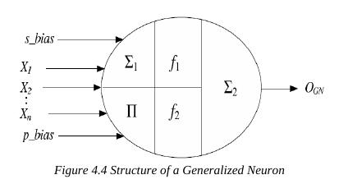
CI BASED SOLUTIONS FOR WSN CHALLENGES (cont.)
4 NEURAL NETWORKS FOR SECURITY:
Multi-layered perceptron and generalized neuron-based (GN) distributed secure MAC protocols are proposed in which NNs on-board WSN nodes monitor traffic variations, and compute a suspicion that an attack is underway. When the suspicion grows beyond a present
threshold, the WSN node is switched off temporarily. A node detects an attack by monitoring abnormally large variations in sensitive parameters

Slide 25
CI BASED SOLUTIONS FOR WSN CHALLENGES (cont.)
GN is a neural network model that is more compact and flexible.
A GN uses both Σ (sum) and Π (product) aggregation functions
WSN nodes monitor traffic variations, and compute a suspicion that an attack is underway. When the suspicion grows beyond a preset threshold, the WSN node is switched off temporarily.
A node detects an attack by monitoring abnormally large variations in sensitive parameters:
Collision rate (Rc)- number of collisions observed by a node per second.
Average waiting time (Tw)-waiting time of a packet in MAC buffer before transmission.
Arrival rate (Rr)- rate of RTS packets received by a node successfully per second

Slide 26
CI BASED SOLUTIONS FOR WSN CHALLENGES (cont.)
5.GN Based Secure MAC Protocol
The GN senses the rise in critical parameters Rc, Rr and Tw and produces the output, i.e. used as a measure of suspicion of an attack that shuts down the node. When the suspicion of an attack exceeds a predefined threshold suspicion level ,the MAC and physical layer of the node is switched off. This results in saving of power that would have been wasted in retransmission of collided packets.
Figure 4.5 Generalized Neuron based MAC Protocol

Slide 27
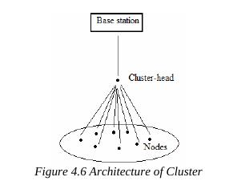
ENERGY AWARE ROUTING AND CLUSTERING
The energy consumption can be reduced by allowing only some nodes to communicate with the base station. These nodes called cluster-heads collect the data sent by each node in that cluster compressing it and then transmitting the aggregated data to the base station. Appropriate cluster-head selection can significantly reduce energy consumption and enhance the lifetime of the WSN. A fuzzy logic approach to cluster-head election is proposed here.

Slide 28
ENERGY AWARE ROUTING AND CLUSTERING (cont.)
1.Fuzzy Cluster-head Election Scheme:
Judicious cluster head election can reduce the energy consumption and extend the lifetime of the network. The operation of the scheme is divided into two rounds each consisting of a setup and steady state phase.
Setup phase- cluster-heads are determined by using fuzzy knowledge processing and then the cluster is organized.
Steady Phase- cluster-heads collect the aggregated data and is then sent to the base station.

Slide 29
ENERGY AWARE ROUTING AND CLUSTERING (cont.)
A fuzzy logic approach based on energy, concentration and centrality is proposed for cluster head election.
Node Energy - energy level available in each node, designated by the fuzzy variable ‘energy’.
Node Concentration - number of nodes present in the vicinity, designated by the fuzzy variable ‘concentration’.
Node Centrality - a value which classifies the nodes based on how central the node is to the cluster, designated by the fuzzy variable ‘centrality’

Slide 30
ENERGY AWARE ROUTING AND CLUSTERING (cont.)
2. Neural Networks:
A QoS driven routing algorithm called sensor intelligence routing (SIR), is presented in for automatic reading of public utility meters. The study utilizes a NN in every node to manage the routes for data flow. A modification over Dijkstra algorithm proposed in the
article finds minimum cost paths from base station to every node. The edge cost parameter between a pair of nodes w_{ij} is determined in each node by a self organizing map, based on QoS parameters latency, error rate, duty cycle and throughput.

Slide 31
ENERGY AWARE ROUTING AND CLUSTERING (cont.)
3.Evolutionary Algorithms:
A GA based multi-hop routing technique named GA-Routing is proposed in
for maximizing network longevity in terms of time to first node death. The challenge here is to come up with a routing algorithm that maximizes the number of rounds before the first node dies. The GA approach proposed here generates aggregation trees, which span all the sensor nodes. Although the best aggregation tree is the most efficient path in the network, continuous use of this path would lead to failure of a few nodes earlier than others. The goal of this study is to
find an aggregation tree, and the number of times a particular
tree is used before the next tree comes in force.

Slide 32
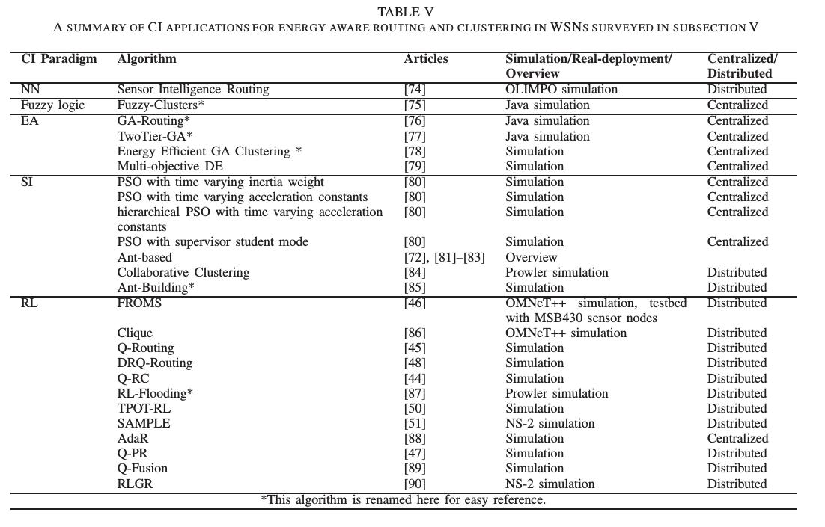
ENERGY AWARE ROUTING AND CLUSTERING (cont.)

Slide 33
ENERGY AWARE ROUTING AND CLUSTERING (cont.)
Simulation results show that GA gives better lifetime than the single best tree algorithm, and GA gives the same lifetime as the cluster based maximum lifetime data aggregation algorithm [92] for small network sizes. However, the algorithm is centralized and the cost of disseminating the optimal routing paths to the nodes is not considered.
Two-Tier GA:
Another application of GA for maximum lifetime routing for a two-tier network is presented in . In a two tier sensor network, a few sensor nodes having higher power levels act as cluster heads. If a cluster head fails due to loss of power, the whole cluster ceases to operate. This influences load on the existing nodes, causing them to deplete their power quickly. Flow-splitting type of routing algorithms are used in such eventuality. The approach discussed in the article uses GA determine a non-flow-splitting routing strategy

Slide 34
ENERGY AWARE ROUTING AND CLUSTERING (cont.)
Energy Efficient GA Clustering:
Another application of GA in energy efficient clustering is described in . The proposed GA represents the sensor nodes as bits of chromosomes, cluster heads as 1 and ordinary nodes as 0. The number of bits in a chromosome is equal to the number of nodes. Fitness of each chromosome is computed as
F = α(w_{i} , f_{i}), ∀f_{i} ∈ {C, D, E, SD, T }
Multi-objective DE: The study presented in [79]
proposes a multi-objective differential evolution algorithm to determine a set of Pareto optimal routes with respect to energy consumption, latency and channel capacity for single and multipath routing problems2. Multi-objective differential evolution produces multiple candidate routes that represent different possible tradeoff between energy consumption and latency for a communication in completely connected network, in which each node knows precise location of every other node.

Slide 35
ENERGY AWARE ROUTING AND CLUSTERING (cont.)
4) Swarm Intelligence:
Four variants of PSO, namely PSO with time varying inertia weight, PSO with time varying acceleration constants, hierarchical PSO with time varying acceleration constants and PSO with supervisor student mode, are proposed for energy aware clustering in [80]. In PSO with time varying inertia weight, the inertia weight w is decreased linearly from 0.9 in first iteration to 0.4 in the last iteration. In PSO with time varying acceleration constants, inertia weight is set constant, and acceleration constants c1 and c2 are varied linearly from 2.5 to 0.5 in every iteration. Therefore, particles move towards the solution in large steps initially, and the step size reduces in every iteration.

Slide 36

ENERGY AWARE ROUTING AND CLUSTERING (cont.)
Collaborative Clustering Algorithm:
In many applications, mere number of living nodes does not represent the effectiveness of the network. For example, a network that has lost a quarter of its nodes from one quadrant is less effective than the network that has lost a quarter of its nodes from the whole area uniformly. A article defines a new parameter for evaluating longevity of wireless sensor networks. The parameter is called Effectiveness, The network longevity is defined as the time for which the network Effectiveness is equal to or greater than 70%.

Slide 37
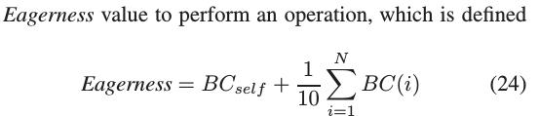
ENERGY AWARE ROUTING AND CLUSTERING (cont.)
Biological soldier ants that have the support of other soldier ants are found to be more aggressive in nature. An ant is observed to exhibit higher eagerness to fight when it is amidst strong ants. This fact inspires the collaborative clustering algorithm for wireless sensor network longevity that possesses good scalability and adaptability features. Here, each node has an Eagerness value to perform an operation, which is defined as

Slide 38
ENERGY AWARE ROUTING AND CLUSTERING (cont.)
5) Reinforcement Learning:
One of the fundamental and earliest works in packet routing using machine learning techniques is Q-Routing [45]. The authors describe a very simple, Q-learning based algorithm, which learns the best paths considering the least latency to the destinations
DRQ-Routing:
DRQ-Routing is based on Q-Routing and uses the same WSN application scenario: routing packets from a source to a sink, while minimizing delivery time of the packets. However, the authors use dual reinforcement learning (See Section III-F). Thus, learning converges faster and the protocol shows better performance. The approach is again fully distributed and uses only local information and feedback appended to packets from neighbouring nodes. However, its communication cost is slightly increased by the backward rewards, compared to Q-Routing

Slide 39
ENERGY AWARE ROUTING AND CLUSTERING (cont.)
Q-RC:
Q-RC (Q-Routing with Compression) [44] presents a routing protocol, where the goal is to aggregate the source packets as early as possible in the path, compress them and send to a single sink. Again, agents are the sensor nodes and the actions are the possible forwarding options to different neighbours. A q-value is associated with each forwarding option and the one with the highest q-value is considered the best. The q-values are initialized according to:
Q(av ) = β ∗ Q1 (av )+ (1 − β) ∗ Q2 (av )

Slide 40
ENERGY AWARE ROUTING AND CLUSTERING (cont.)
AdaR:
Yet another Q-Learning based routing mechanism is presented in [88]. It uses an offline learning procedure, based on Q-learning and claims to learn the routing value function faster than traditional Q-Learning. The setting is similar to those presented above: many source nodes are sending data to a single base station. The algorithm takes into account the aggregation ratio, the residual energy on the nodes, the hop cost to the base station and the link reliability between the nodes.

Slide 41
ENERGY AWARE ROUTING AND CLUSTERING (cont.)
RL-Flooding:
is a constrained flooding routing technique, able to handle very dynamic WSN environments. Its basic idea consists of learning the costs to the single sink at each node in the network by using Q-Learning (very similar to the above proposed approaches). The costs can be defined as any metric based on hops, remaining energy on the nodes, energy required to reach the sink, etc. However, instead of using the single best route to route the packet, RL-Flooding allows all neighbours, whose cost to the sink is not greater than that of the last hop to forward the node. This makes the routing very flexible and the data delivery very fast and reliable. However, in more static and reliable environments it causes a lot of additional communication overhead.

Slide 42
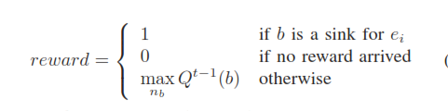
ENERGY AWARE ROUTING AND CLUSTERING (cont.)
Q-Fusion:
A Q-Learning based routing protocol with somewhat different goal is presented in [89], where sensing nodes disseminate data tuples from military target detection applications to interested nodes. However, sinks or interested nodes are defined as forwarding nodes, able to fuse the data about some detected event e_{i} . The authors apply a Q-Learning technique, where the rewards (feedbacks) are defined for a data packet e_{i} as:

Slide 43
ENERGY AWARE ROUTING AND CLUSTERING (cont.)
Q-PR:
Q-Probabilistic Routing [47] is another variation of Q-Routing, where a geographic-based routing protocol is implemented for routing data from single source to a single sink. In each step of the algorithm to the sink a subset of neighbouring nodes is selected to forward the packet. A complex coordination algorithm is implemented to make sure that even under highly lossy links the message is forwarded. The underlying approach is though based on Q-Learning,
RLGR:
Another geographic-based routing protocol for WSNs based on reinforcement learning is RLGR [90]. The authors use RL to learn the best next hop to reach a single sink in a network, using a reward function which includes besides the traditional geographic progress to the sink also remaining energy on the nodes and automatic avoidance of void areas.

Slide 44
ENERGY AWARE ROUTING AND CLUSTERING (cont.)
TPOT-RL-Routing:
The authors of TPOT-RL (see Section III-F) have applied their algorithm to packet routing in a network in [50]. TPOT-RL should be usually used when many agents act as a team and have to learn to cooperate in some task, without really knowing what the others are actually doing. The goal of the paper is a proof-of-concept of the wide applicability of the algorithm rather than developing a high-performance routing protocol and thus does not provide any comparison to other approaches. Besides this, although

Slide 45
ENERGY AWARE ROUTING AND CLUSTERING (cont.)
SAMPLE:
Collaborative RL (see Section III-F) is defined and applied to optimal routing in a mobile ad hoc network in [51]. The approach learns the optimal routing policy through feedback among agents, using Boltzmann exploration strategy. A routing protocol is implemented on top of collaborative RL, called SAMPLE, and tested in different network topologies with various mobility. The approach is fully distributed and the implementation is feasible also for WSNs, since all routing information is sent together with the data packets.

Slide 46
ENERGY AWARE ROUTING AND CLUSTERING (cont.)
FROMS:
An energy-aware multicast routing protocol based on Q-Learning called FROMS is presented in [46]. Its goal is to minimize the energy spent in a network, while delivering packets to many sinks simultaneously. The idea is based on an optimal broadcast Steiner tree, where a minimum number of broadcasts are needed to deliver one packet from an independent source to all sinks.

Slide 47

ENERGY AWARE ROUTING AND CLUSTERING (cont.)
The Q-values of the sub-actions are initialized based on the individual hop counts to each of the sinks, which are disseminated during an announcement message from each sink. This initial value is an upper bound estimate of the real costs:

Slide 48
ENERGY AWARE ROUTING AND CLUSTERING (cont.)
Clique:
An attempt to efficiently solve the clustering problem in WSNs in presented in [86]. The most important disadvantage of traditional clustering algorithms is their high communication overhead for forming the clusters, and electing and announcing the cluster heads.
Clique [86] solves the problem by avoiding all-over the cluster head selection process. It assumes the nodes in the WSN have some a-priori clustering information, like a simple geographic grid or room or floor information in a building.

Slide 49
SCHEDULING, DATA AGGREGATION AND SENSOR FUSION, AND QOS MANAGEMENT
A) Scheduling
Several aspects of scheduling in WSNs are accomplished through CI techniques like fuzzy neural network, GA, AIS, RL and hybrids of PSO and GA. Table VI summarizes some CI based solutions to scheduling in WSN discussed below.
1. Fuzzy Neural Network:
A fuzzy Hopfield neural network is proposed in [97] to solve the TDMA broadcast scheduling problem in WSNs. The problem is treated as discrete energy minimization problem that is mapped into a Hopfield neural network. The objective of the broadcast scheduling problem is to find a conflict-free transmission schedule for each node in TDMA slots. The optimisation criterion is to find the TDMA schedule having minimal TDMA cycle length and maximum node transmissions

Slide 50
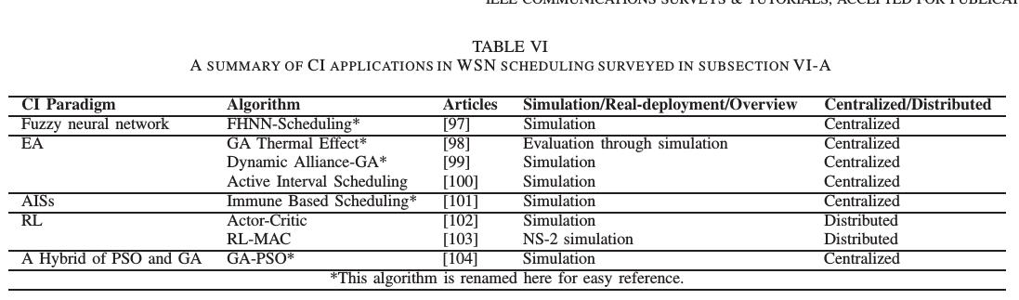
SCHEDULING, DATA AGGREGATION AND SENSOR FUSION, AND QOS MANAGEMENT(cont.)

Slide 51
SCHEDULING, DATA AGGREGATION AND SENSOR FUSION, AND QOS MANAGEMENT(cont.)
2. Evolutionary Algorithms:
GA is employed effectively in communication scheduling to minimize the effects of bio-heating from tissue implanted bio-sensor network in [98]. Tissues are sensitive to increase in temperature resulting from normal operation of sensor nodes. The cluster heads that transmit more frequently, or those at higher power level are likely to cause more damage to tissues. Therefore, it is necessary to rotate cluster head allocation in order to minimize thermal effects.
3) Artificial Immune Systems:
An immune system based node scheduling scheme is presented for power minimization and collision pre-emption in [101]. The objectives of the scheme are to optimize the route of each hop of N nodes to minimize power consumed, and to order the nodes in path ensuring collision free propagation. In the proposed method, antigen (problem domain) is represented as sets of A(i), i=1,2,. . . ,N , where i denotes serial number of a node, and A(i) denotes its index.

Slide 52
SCHEDULING, DATA AGGREGATION AND SENSOR FUSION, AND QOS MANAGEMENT(cont.)
4) Reinforcement Learning:
Actor Critic Algorithm, a near optimal point-to-point communication framework based on RL is presented in [102]. The goal of the algorithm is to maximize throughput per total consumed energy in a sensor network, based on node-to-node communication. Given its current buffer size and last channel transmission gain, the node decides the best modulation level and transmission power to maximize the total throughput per consumed energy.
5) Hybrid Algorithms:
TDMA-based medium access control is a popular technique used in sensor networks because it can reduce the delay, provide real-time guarantees and save power by eliminating collisions. It is customary in such a MAC to send the node in sleep mode when there is no need of transmission. But, unnecessary state transitions between the active and sleep modes lead to wastage of energy

Slide 53
SCHEDULING, DATA AGGREGATION AND SENSOR FUSION, AND QOS MANAGEMENT(cont.)
B. Data Aggregation and Sensor Fusion
Some CI based solutions to data aggregation and sensor fusion problem are discussed below and summarized in Table VII. The methods capable of automatic adjustment and self-adaptation are required for intelligent fusion of information from distributed nodes in a multi-sensor network. Data aggregation and sensor fusion are addressed through GA, fuzzy logic, RL and NNs.
A centralized approach like neural networks, GA or PSO can be successfully applied to learn the properties of the data.

Slide 54
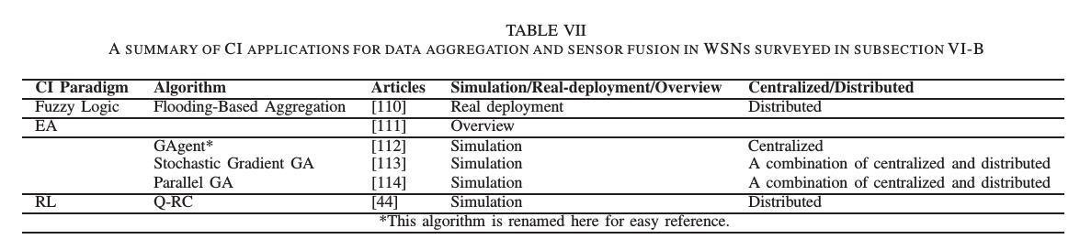
SCHEDULING, DATA AGGREGATION AND SENSOR FUSION, AND QOS MANAGEMENT(cont.)

Slide 55
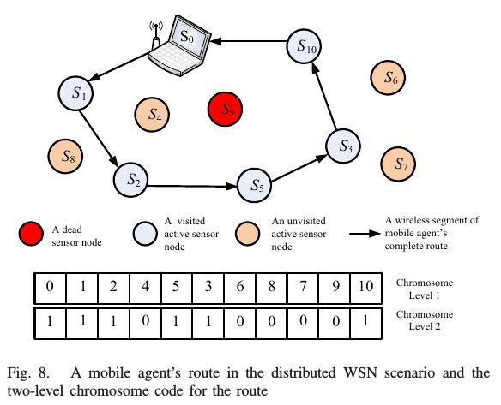
SCHEDULING, DATA AGGREGATION AND SENSOR FUSION, AND QOS MANAGEMENT(cont.)

Slide 56
SCHEDULING, DATA AGGREGATION AND SENSOR FUSION, AND QOS MANAGEMENT(cont.)
1) Fuzzy Logic:
A novel distributed approach based on fuzzy numbers and weighted average operators to perform an energy efficient flooding-based aggregation is proposed in [110]. In this study, each sensor node maintains an estimate of the aggregation value represented as a symmetric triangular fuzzy number. Aggregation is done at each node if either a new measurement value is locally available to the node, or if a new value is received from a neighbouring node. Each node maintains a table of sensor values received from neighbouring nodes. Based on the estimate, a node decides if a newly measured sensor data has to be propagated in the network or not. This reduces the number of messages transmitted,

Slide 57
SCHEDULING, DATA AGGREGATION AND SENSOR FUSION, AND QOS MANAGEMENT(cont.)
2) Evolutionary Algorithms:
Article [111] gives an overview of basic and advanced concepts, models, and variants of GA in various applications in information fusion.
GAgent: The issue of data aggregation for a target detection application is addressed in [112] through mobile agent-based distributed sensor networks wherein a mobile agent selectively visits the sensors and incrementally fuses the appropriate measurement data. GA is used to determine the optimal route for the agent to traverse (thus, the name GAgent).

Slide 58
SCHEDULING, DATA AGGREGATION AND SENSOR FUSION, AND QOS MANAGEMENT(cont.)
GA-Stochastic Gradient and Parallel GA: GA is used in [113] and[114] to address the problem of optimal detection
performance in sensor networks that have communication
constraints. Both the studies consider the parallel fusion
architecture in which local sensors feed their quantized
decisions to a single fusion center through the medium that has a bit rate constraint. N sensors gather T measurements y_{n,t} of a state of nature H per sensor, make a local decision u_{n,t}
per measurement using a mapping function γ_{n} and send local
decisions to a single fusion centre.

Slide 59
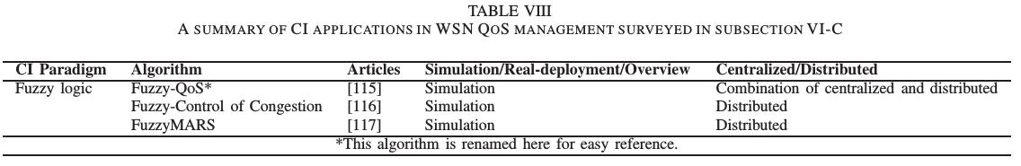
SCHEDULING, DATA AGGREGATION AND SENSOR FUSION, AND QOS MANAGEMENT(cont.)
3) Reinforcement Learning:
As mentioned above, RL has been successfully applied to learning the best aggregation and routing path to the sink in a distributed manner, like the Q-RC protocol.
C. QoS Management
Table VIII lists the CI applications in QoS management discussed here. A holistic QoS approach has not received significant research attention, and energy efficiency has been the main QoS metric in research efforts.

Slide 60
SCHEDULING, DATA AGGREGATION AND SENSOR FUSION, AND QOS MANAGEMENT(cont.)
1) Fuzzy logic: A fuzzy logic based congestion estimation method within a proposed QoS architecture Fuzzy-QoS is presented in [115]. The architecture comprises of a QoS Management and Control module which is implemented both at node level and at the sink for a system level QoS administration. The Fuzzy-QoS approach uses packet arrival rate and buffer size in a sensor node to determine and maintain a fuzzy table for the conditions of buffer congestion. The fuzzy set consists of two fuzzy variables: packet arrival rate (p) and buffer size (s), A # = {p, s}. Each of these fuzzy variables takes values of 0, 0.5or1 depending on low, medium or high congestion conditions. Then, the fuzzy table is computed using max-min composition.

Slide 61
GUIDE TO CI METHODS FOR WSNS
Many CI methods have outperformed or complimented conventional methods under uncertain environments and severe limitations in power supply, communication bandwidth, and computational capabilities. However, all works presented here are not the best possible solutions and many have not been compared to traditional or to other CI approaches. Additionally, only a few researchers have evaluated their algorithms under real WSN environments like test-bed or deployments.

Slide 62
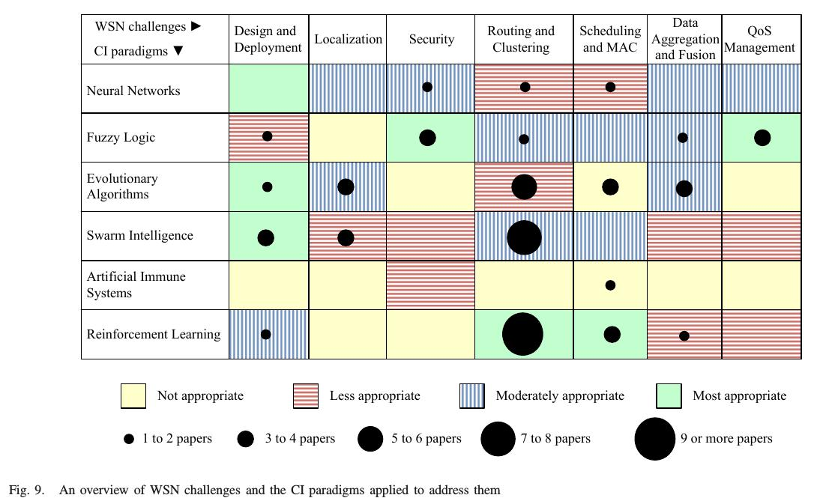
GUIDE TO CI METHODS FOR WSNS(cont.)

Slide 63
GUIDE TO CI METHODS FOR WSNS(cont.)
It is interesting to note that two CI techniques, NNs and AIS, have been rarely applied to WSNs. This is particularly awkward in the case of NNs, because this paradigm is very well studied and there exist many different NN models with different properties. AISs are rather a new research area and are not so well studied. They could be good solutions to security problems, but a general evaluation remains open to future research

Slide 64
CONCLUSIONS AND FUTURE APPLICATIONS OF CI IN WSN S
Recent literature shows that researchers have focused their attention on innovative use of CI techniques to address WSN issues such as design and deployment, localization, security, optimal routing and clustering, scheduling, data aggregation and fusion, and QoS management. Recent implementations of CI methods in various dynamical and heterogeneous networks are presented in this survey paper. CI paradigms and numerous challenges in sensor networks are briefly introduced, and the CI approaches used by researchers to address the challenges are briefly explained. In addition, a general evaluation of CI algorithms is presented, which will serve as a guide for using CI algorithms for WSNs. An advanced CI approach called adaptive critic design holds promise to generate practical optimal/sub-optimal solutions to the distributed sensor scheduling problem. There are successful applications of adaptive critic designs in power systems, which show that the technique provides guaranteed stable optimal solutions under uncertainties and noise [118].
The potential of adaptive critic designs remains to be exploited in the field of WSN scheduling.

Slide 65
REFERENCES
[1] I. Akyildiz, W. Su, Y. Sankarasubramaniam, and E. Cayirci, “A survey on sensor networks,” IEEE Commun. Mag., vol. 40, no. 8, pp. 102–114, Aug. 2002.
[2] C. Y. Chong and S. Kumar, “Sensor networks: Evolution, opportunities, and challenges,” Proc. IEEE, vol. 91, no. 8, pp. 1247–1256, Aug. 2003.
[3] G. Werner-Allen, K. Lorincz, M. Ruiz, O. Marcillo, J. Johnson, J. Lees, and M. Welsh, “Deploying a wireless sensor network on an active volcano,” IEEE Internet Comput., vol. 10, no. 2, pp. 18–25, 2006.
[4] K. Martinez, P. Padhy, A. Riddoch, R. Ong, and J. Hart, “Glacial
Environment Monitoring using Sensor Networks,” in Proc. 1st
Workshop Real-World Wireless Sensor Netw. (REALWSN), Stockholm, Sweden, 2005, p. 5.
[5] I. Talzi, A. Hasler, S. Gruber, and C. Tschudin, “Permasense:
Investigating permafrost with a WSN in the swiss alps,” in Proc. 4th
Workshop Embedded Netw. Sensors (EmNets), Cork, Ireland, 2007, pp.
8–12.
[6] S. Tilak, N. B. Abu-Ghazaleh, and W. Heinzelman, “A taxonomy of
wireless micro-sensor network models,” SIGMOBILE Mob. Comput.
Commun. Rev., vol. 6, no. 2, pp. 28–36, 2002.
[7] K. Langendoen, A. Baggio, and O. Visser, “Murphy loves potatoes:
experiences from a pilot sensor network deployment in precision
agriculture,” in Proc. 20th Int. Symp Parallel Distributed Proc. Symp.
(IPDPS), Rhodes Island, Greece, 2006.
[8] J. McCulloch, P. McCarthy, S. M. Guru, W. Peng, D. Hugo, and
A. Terhorst, “Wireless sensor network deployment for water use
efficiency in irrigation,” in Proc. Conf. Workshop Real-world Wireless
Sensor Netw. (REALWSN), Glasgow, Scotland, 2008, pp. 46–50.
[9] E. A. Basha, S. Ravela, and D. Rus, “Model-based monitoring for early
warning flood detection,” in Proc. Conf. 6th ACM Conf. Embedded
Netw. Sensor Syst. (SenSys), New York, NY, USA, 2008, pp. 295–308.
[10] G. Barrenetxea, F. Ingelrest, G. Schaefer, and M. Vetterli, “The
hitchhiker’s guide to successful wireless sensor network deployments,”
in Proc. 6th ACM Conf. Embedded Netw. Sensor Syst. (SenSys), New
York, NY, USA, 2008, pp. 43–56.
[11] T. Naumowicz, R. Freeman, A. Heil, M. Calsyn, E. Hellmich,
A. Braendle, T. Guilford, and J. Schiller, “Autonomous monitoring
of vulnerable habitats using a wireless sensor network,” in Proc. 3rd
Workshop Real-World Wireless Sensor Netw. (REALWSN), Glasgow,
Scottland, 2008, pp. 51–55.
[12] R. Szewczyk, J. Polastre, A. Mainwaring, and D. Culler, “Lessons
from a sensor network expedition,” in Proc. 1st European Workshop
Sensor Netw. (EWSN), Berlin, Germany, 2004, pp. 307–322. [Online].
Available: http://www.cs.berkeley.edu/~polastre/papers/ewsn04.pdf
[13] I. F. Akyildiz, W. Su, Y. Sankarasubramaniam, and E. Cayirci,
“Wireless sensor networks: A survey,” Computer Netw., vol. 38, no. 4,
pp. 393–422, 2002.
[14] E. Cayirci and T. Coplu, “SENDROM: Sensor networks for disaster
relief operations management,” Wireless Netw., vol. 13, no. 3, pp.
409–423, 2007.
[15] G. Wittenburg, K. Terfloth, F. López Villafuerte, T. Naumowicz,
H. Ritter, and J. Schiller, “Fence monitoring – experimental evaluation
of a use case for wireless sensor networks,” in Proc. 4th European
Conf. Wireless Sensor Netw. (EWSN), Delft, The Netherlands, 2007,
pp. 163–178.
[16] S. R. Madden, M. J. Franklin, J. M. Hellerstein, and W. Hong,
“TinyDB: An acquisitional query processing system for sensor
networks,” ACM Trans. Database Syst., vol. 30, no. 1, pp. 122–173,
2005.
[17] N. Patwari, J. Ash, S. Kyperountas, A. Hero, R. Moses, and N. Correal,
“Locating the nodes: Cooperative localization in wireless sensor
networks,” IEEE Signal Process. Mag., vol. 22, no. 4, pp. 54–69, July
2005.
[18] J. Aspnes, T. Eren, D. Goldenberg, A. Morse, W. Whiteley, Y. Yang,
B. Anderson, and P. Belhumeur, “A theory of network localization,”
IEEE Trans. Mobile Comput., vol. 5, no. 12, pp. 1663–1678, Dec.
2006.
[19] A. Boukerche, H. Oliveira, E. Nakamura, and A. Loureiro,
“Localization systems for wireless sensor networks,” IEEE Wireless
Commun. Mag., vol. 14, no. 6, pp. 6–12, Dec. 2007.
[20] I. Guvenc and C.-C. Chong, “A survey on TOA based wireless
localization and NLOS mitigation techniques,” IEEE Commun. Surveys
Tuts., vol. 11, no. 3, pp. 107–124, 2009.
[21] R. R. Brooks and S. S. Iyengar, Multi-sensor Fusion: Fundamentals
and Applications with Software. Upper Saddle River, NJ, USA:
Prentice-Hall, Inc., 1998.
[22] R. Rajagopalan and P. Varshney, “Data-aggregation techniques in
sensor networks: A survey,” IEEE Commun. Surveys Tuts., vol. 8, no. 4,
pp. 48–63, Fourth Quarter 2006.
[23] P. Jiang, Y. Wen, J. Wang, X. Shen, and A. Xue, “A study of routing
protocols in wireless sensor networks,” in Proc. 6th World Congress
Intelligent Control Automation WCICA 2006, Y. Wen, Ed., vol. 1, 2006,
pp. 266–270.
[24] F. Hu and N. K. Sharma, “Security considerations in ad hoc sensor
networks,” Ad Hoc Netw., vol. 3, no. 1, pp. 69–89, 2005.
[25] C. Karlof and D. Wagner, “Secure routing in wireless sensor networks:
Attacks and countermeasures,” Elsevier’s AdHoc Netw. J., Special Issue
Sensor Netw. Appl. Protocols, vol. 1, no. 2–3, pp. 293–315, Sept. 2003.
[26] X. Chen, K. Makki, K. Yen, and N. Pissinou, “Sensor network security:
A survey,” IEEE Commun. Surveys Tuts., vol. 11, no. 2, pp. 52–73,
2009.
[27] D. Chen and P. Varshney, “QoS support in wireless sensor networks:
A survey,” June 2004.
[28] G. K. Venayagamoorthy, “A successful interdisciplinary course on
computational intelligence,” IEEE Computational Intelligence Mag.,
vol. 4, no. 1, pp. 14–23, 2009.
[29] A. Engelbrecht, Computational Intelligence: An Introduction, 2nd ed.
NY, USA: John Wiley & Sons, 2007.
[30] A. Konar, Computational Intelligence: Principles, Techniques and
applications. Springer, 2005.
[31] S. Haykin, Neural Networks: A Comprehensive Foundation. Prentice
Hall, 1994.

Slide 66
REFERENCES
[5] I. Talzi, A. Hasler, S. Gruber, and C. Tschudin, “Permasense:
Investigating permafrost with a WSN in the swiss alps,” in Proc. 4th
Workshop Embedded Netw. Sensors (EmNets), Cork, Ireland, 2007, pp.8–12.
[6] S. Tilak, N. B. Abu-Ghazaleh, and W. Heinzelman, “A taxonomy of wireless micro-sensor network models,” SIGMOBILE Mob. Comput. Commun. Rev., vol. 6, no. 2, pp. 28–36, 2002.
[7] K. Langendoen, A. Baggio, and O. Visser, “Murphy loves potatoes:experiences from a pilot sensor network deployment in precision agriculture,” in Proc. 20th Int. Symp Parallel Distributed Proc. Symp. (IPDPS), Rhodes Island, Greece, 2006.
[8] J. McCulloch, P. McCarthy, S. M. Guru, W. Peng, D. Hugo, and
A. Terhorst, “Wireless sensor network deployment for water use
efficiency in irrigation,” in Proc. Conf. Workshop Real-world Wireless Sensor Netw. (REALWSN), Glasgow, Scotland, 2008, pp. 46–50.

Slide 67
REFERENCES
[111] I. V. Maslov and I. Gertner, “Multi-sensor fusion: An evolutionary algorithm approach,” Inf. Fusion, vol. 7, no. 3, pp. 304–330, 2006.
[112] Q. Wu, N. Rao, J. Barhen, S. Iyengar, V. Vaishnavi, H. Qi, and K. Chakrabarty, “On computing mobile agent routes for data fusion in distributed sensor networks,” IEEE Trans. Knowledge Data Eng.,vol. 16, no. 6, pp. 740–753, June 2004.
[113] S. Aldosari and J. Moura, “Fusion in sensor networks with
communication constraints,” in Proc. 3rd Int. Symp. Inf. Process. Sensor Netw. IPSN, 2004, pp. 108–115.
[114] N. Gnanapandithan and B. Natarajan, “Parallel genetic algorithm based optimal fusion in sensor networks,” in Proc. 3rd IEEE Consumer Commun. Netw. Conf. CCNC, vol. 2, 2006, pp. 763–767.

